Slide 1

Final Project for Data Mining Course Data Science and Application Program - Metro College of Technology
Ana Clara Tupinambá Freitas
oriented by Professor Gitimoni Saikia
September, 2021

Slide 2
COVID Cases – Linear Regression
The past couple years have been disrupted by the COVID-19 pandemic.
The predictors of this study are:
- Outbreak Associated
- Age Group
- Season
- Episode Month
- Client Gender
- The target feature in this study will be Count of CONFIRMED cases.
This study will try to answer some questions:
- What factors may contribute to COVID positive numbers in Toronto?
- What groups should be the target of more attention?
- When should precaution be highlighted to persist?
Data Source: https://open.toronto.ca/dataset/covid-19-cases-in-toronto/ , downloaded at Sep 7th, 2021

Slide 3
Preprocessing
 | Total | # Missing | % Missing
Age Group | 174392 | 100 | 0.06
Assigned_ID | 174392 | 0 | 0
Classification | 174392 | 0 | 0
Client Gender | 174392 | 0 | 0
Currently Hospitalized | 174392 | 0 | 0
Currently Intubated | 174392 | 0 | 0
Currently in ICU | 174392 | 0 | 0
Episode Date | 174392 | 0 | 0
Ever Hospitalized | 174392 | 0 | 0
Ever Intubated | 174392 | 0 | 0
Ever in ICU | 174392 | 0 | 0
FSA | 174392 | 1339 | 0.77
Neighbourhood Name | 174392 | 2829 | 1.62
Outbreak Associated | 174392 | 0 | 0
Outcome | 174392 | 0 | 0
Reported Date | 174392 | 0 | 0
Source of Infection | 174392 | 0 | 0
_id | 174392 | 0 | 0
Shape: 645 x 6
Predictors
Grouped by:
Outbreak Associated
Age Group
Season
Episode Month
Client Gender
Target:
Count of: _id (rows)
 | Outbreak Associated | Age Group | Season | Episode Month | Client Gender | Count
0 | Outbreak Associated | 19 and younger | Autumn | 9 | FEMALE | 25
1 | Outbreak Associated | 19 and younger | Autumn | 9 | MALE | 28
2 | Outbreak Associated | 19 and younger | Autumn | 9 | UNKNOWN | 1
3 | Outbreak Associated | 19 and younger | Autumn | 10 | FEMALE | 60
4 | Outbreak Associated | 19 and younger | Autumn | 10 | MALE | 71
... | ... | ... | ... | ... | ... | ...
640 | Sporadic | 90 and older | Winter | 1 | MALE | 44
641 | Sporadic | 90 and older | Winter | 2 | FEMALE | 31
642 | Sporadic | 90 and older | Winter | 2 | MALE | 30
643 | Sporadic | 90 and older | Winter | 12 | FEMALE | 74
644 | Sporadic | 90 and older | Winter | 12 | MALE | 45
Shape: 174,392 x18
No missing values

Slide 4
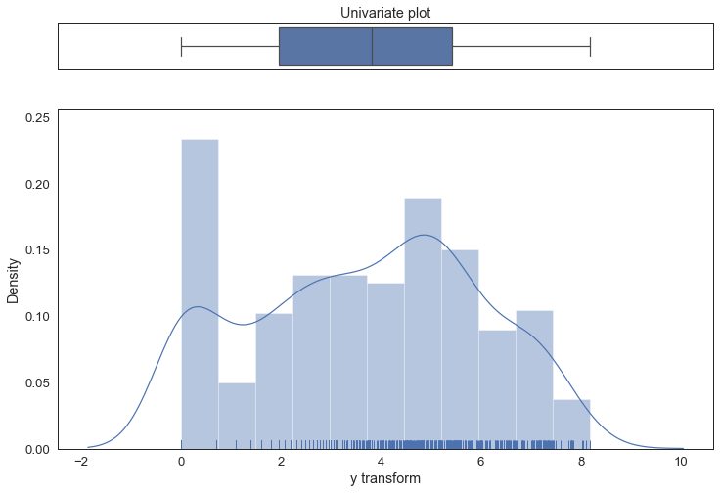
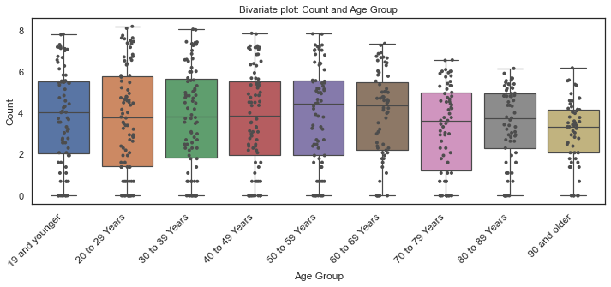
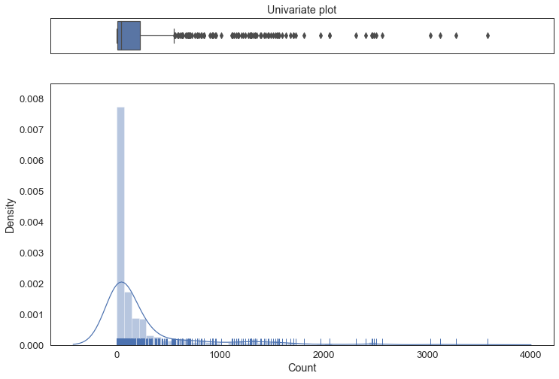
Summary
 | count | unique | top | freq | mean | std | min | 25% | 50% | 75% | max
Outbreak Associated | 28199 | 2 | Sporadic | 19712 | NaN | NaN | NaN | NaN | NaN | NaN | NaN
Age Group | 28199 | 9 | 20 to 29 Years | 4156 | NaN | NaN | NaN | NaN | NaN | NaN | NaN
FSA | 28199 | 97 | M9V | 477 | NaN | NaN | NaN | NaN | NaN | NaN | NaN
Episode Month/Year | 28199 | 20 | 4/2021 | 2783 | NaN | NaN | NaN | NaN | NaN | NaN | NaN
Client Gender | 28199 | 9 | FEMALE | 13537 | NaN | NaN | NaN | NaN | NaN | NaN | NaN
Count | 28199 | NaN | NaN | NaN | 5.9185 | 9.51 | 1 | 1 | 2 | 6 | 150
log
We can see that there are difference between the groups distributions and this is confirmed by Kruskal's test.

Slide 5
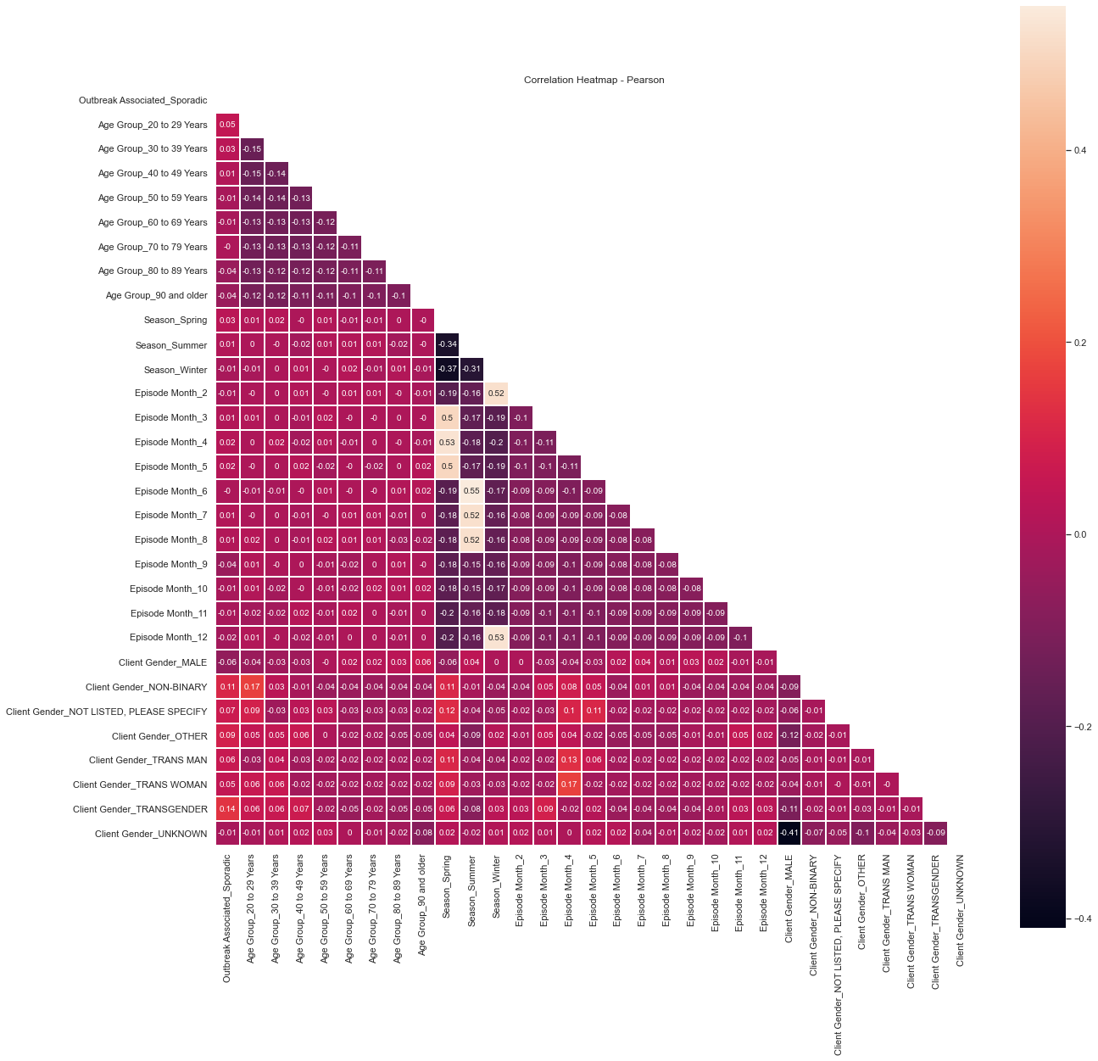
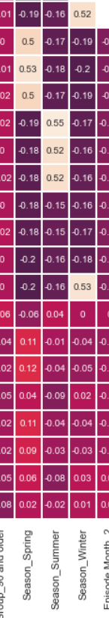
Collinearity?

Slide 6
Equation
-3019807574453.0933 + (1.5441079663223745)*Outbreak Associated_Sporadic +
(0.35638162207921087)*Age Group_20 to 29 Years + (0.1483642524550446)*Age Group_30 to 39 Years +
(0.019967929529485447)*Age Group_40 to 49 Years + (-0.12071009668849385)*Age Group_50 to 59 Years +
(-0.5075667886416892)*Age Group_60 to 69 Years + (-1.0606926328873354)*Age Group_70 to 79 Years +
(-1.1114359496043367)*Age Group_80 to 89 Years + (-1.750224393004825)*Age Group_90 and older +
(2943219376811.681)*Season_Spring + (2763434204188.5405)*Season_Summer +
(3019807574458.3223)*Season_Winter + (-0.7900069436320135)*Episode Month_2 +
(76588197646.71722)*Episode Month_3 + (76588197647.52966)*Episode Month_4 +
(76588197646.74487)*Episode Month_5 + (256373370268.61624)*Episode Month_6 +
(256373370267.62393)*Episode Month_7 + (256373370267.8137)*Episode Month_8 +
(3019807574456.811)*Episode Month_9 + (3019807574457.4883)*Episode Month_10 +
(3019807574458.0522)*Episode Month_11 + (-0.02222203034754386)*Episode Month_12 +
(-0.14497191419782268)*Client Gender_MALE + (-6.220768909081815)*Client Gender_NON-BINARY +
(-7.4237152475312795)*Client Gender_NOT LISTED, PLEASE SPECIFY +
(-6.294551815915116)*Client Gender_OTHER + (-7.448327680133801)*Client Gender_TRANS MAN +
(-7.913160888469843)*Client Gender_TRANS WOMAN +
(-6.496409263406269)*Client Gender_TRANSGENDER + (-3.6555597772430795)*Client Gender_UNKNOWN

Slide 7
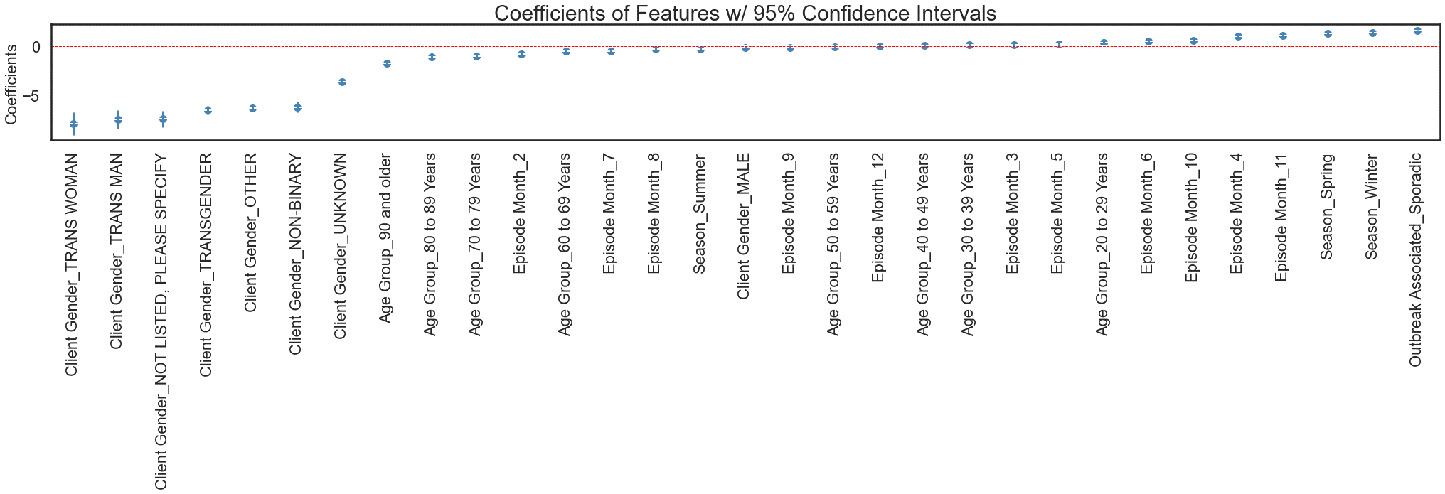
Model
Training score:
Training R2 = 0.8836483399582606
Training Adj-R2 = 0.8750399832487286
Testing score:
Test R2 = 0.8701121896301919
Test Adj-R2 = 0.8452571148063397
RMSE value: 0.8550471737644835
Cross validation score is: 0.5974384121669322
Intercept: -3019807574453.0933

Slide 8
Conclusions / Inferences
This model may explain society’s factors but with caution since k-fold R-Square value is very low.
This model points, for example:
Being a female have more risk of having a positive case of COVID by a variation of +7.91 compared to a trans-woman, suggesting that more attention may be given to females to diminish their exposition.
We also see that outbreak contamination presents a higher risk than sporadic ones explaining the variation of positive cases by approximately +1.5, indicating that it’s past due to give proper care to such sites.
Winter and Spring have also an impact in rising the risk of positive cases.
A different model (non-linear) may be better to predict the output feature.

Slide 9
Car evaluation– Logistic Regression
Can we predict the acceptability of a car?
The features for this study are:
The **target** feature in this study will be: **Class**.
Data Source: https://archive.ics.uci.edu/ml/datasets/Car+Evaluation , downloaded at Sep 9th,2021
*Class:
- unacceptable,
- Acceptable
- Good
- Very good
*Buying:
- Very high
- High
- Medium
- Low
*Maintenance:
- Very high
- High
- Medium
- Low
*Doors:
- 2
- 3
- 4
- 5more.
*Persons:
- 2
- 4
- more
*Lugagge boot:
- small
- medium
- big
*Safety:
- low
- medium
- high

Slide 10
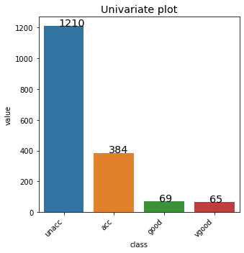
Preprocessing / Summary
Shape: 1728 x 7
Summary
 | Total | # Missing | % Missing
buying | 1728 | 0 | 0
class | 1728 | 0 | 0
doors | 1728 | 0 | 0
lug_boot | 1728 | 0 | 0
maint | 1728 | 0 | 0
persons | 1728 | 0 | 0
safety | 1728 | 0 | 0
persons | 1728 | 0 | 0
safety | 1728 | 0 | 0
 | count | unique | top | freq
buying | 1728 | 4 | high | 432
maint | 1728 | 4 | high | 432
doors | 1728 | 4 | 2 | 432
persons | 1728 | 3 | 2 | 576
lug_boot | 1728 | 3 | big | 576
safety | 1728 | 3 | high | 576
class | 1728 | 4 | unacc | 1210

Slide 11
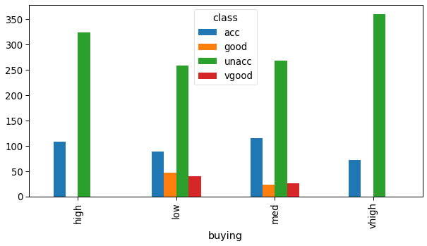
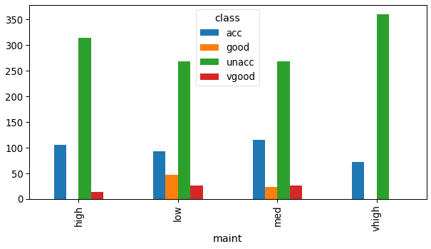
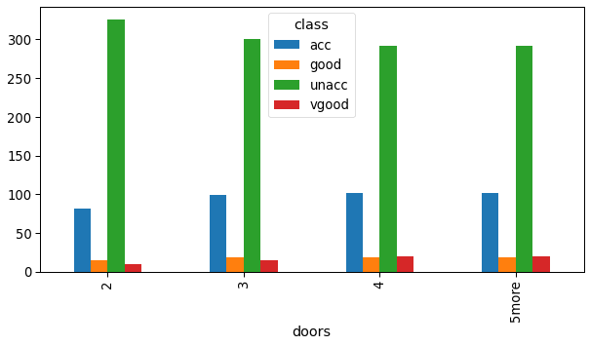
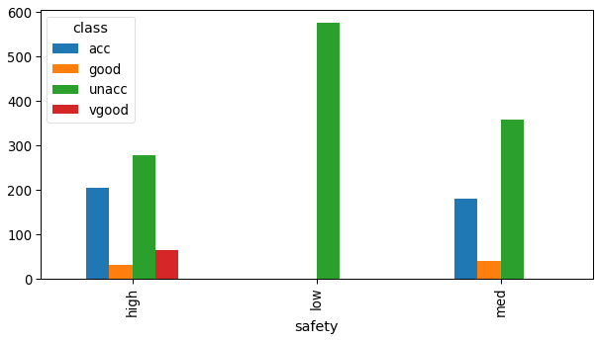
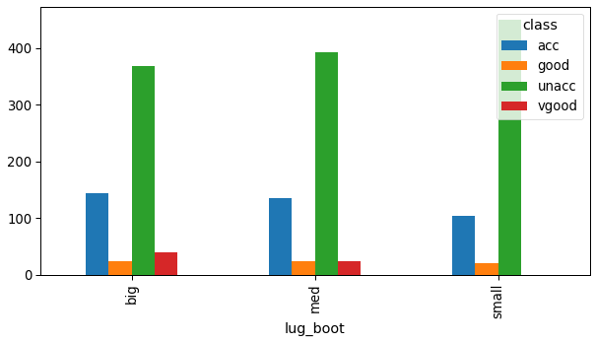
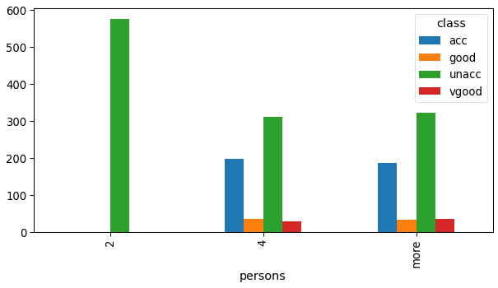
Analysis
Chi-sqare's results:
DOF: 9
p-value= 5.9280625992133936e-36
Reject Null Hypothesis. There's some correlation between variables.
Chi-sqare's results:
DOF: 9
p-value= 2.5476519845077733e-26
Reject Null Hypothesis. There's some correlation between variables.
Chi-sqare's results:
DOF: 9
p-value= 0.32024215990030563
Fail to reject Null Hypothesis. There's no correlation between variables.
Chi-sqare's results:
DOF: 6
p-value= 2.389155399044034e-100
Reject Null Hypothesis. There's some correlation between variables.
Chi-sqare's results:
DOF: 6
p-value= 1.0294402753134833e-09
Reject Null Hypothesis. There's some correlation between variables.
Chi-sqare's results:
DOF: 6
p-value= 4.039968047270742e-77
Reject Null Hypothesis. There's some correlation between variables.

Slide 12
Model
Training score:
Accuracy= 0.9247311827956989
Testing score:
Accuracy= 0.8940269749518305
Cross validation score is: 0.7360643377733098
Min value: 0.672463768115942 Max value: 0.838150289017341
Confusion Matrix(test):
Classification Report (test):
Acc | Good | Unacc | Vgood
94 | 5 | 15 | 1
11 | 10 | 0 | 4
17 | 0 | 346 | 0
1 | 0 | 0 | 15
 | precision | recall | f1-score | support
acc | 0.76 | 0.82 | 0.79 | 115
good | 0.71 | 0.40 | 0.51 | 25
unacc | 0.96 | 0.95 | 0.95 | 363
vgood | 0.75 | 0.94 | 0.83 | 16
accuracy |  |  | 0.90 | 519
macro avg | 0.80 | 0.78 | 0.77 | 519
weighted avg | 0.90 | 0.90 | 0.89 | 519

Slide 13
Conclusions / Inferences
Despite the data being unbalanced, the model is a good fit, giving correct predictions(accuracy) at a range of 67 % to 83%, with an average accuracy of 73%.
There is great precision(96%) specially to the most business risk category: Unacceptable

Slide 14
Thank you! Questions?

